Slide 1
TypeA Project Project Structure
JGG)CA) Service Control Group​
Application Development Standardization Promotion Team​
2023/3​

Slide 2
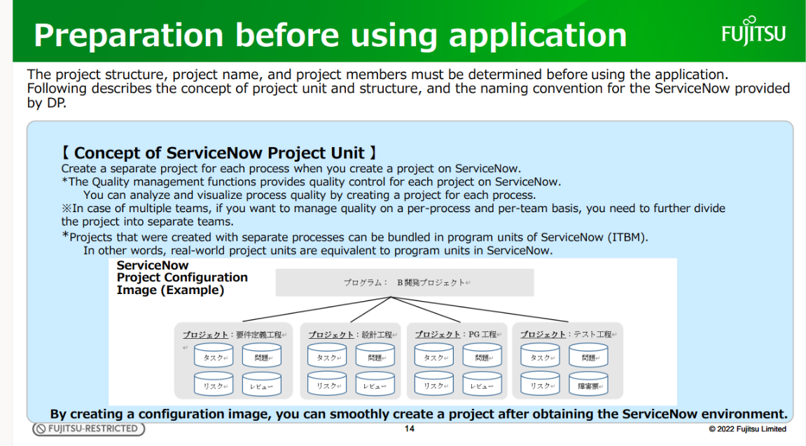
FYI) ServiceNow Structure Description
ServiceNow (ITBM)
From the Introduction Guide page 14
Program :
B Development Project
Project: Requirement Definition Process
Project:
Design Process
Project:
PG Process
Project:
Test Process

Slide 3
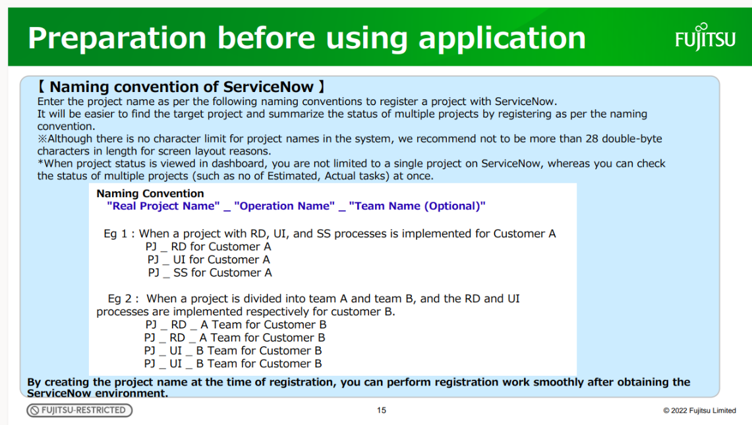
FYI) ServiceNow Structure Description
ServiceNow (ITBM)
From the Introduction Guide page 15

Slide 4
[TypeA] Naming Conventions for ServiceNow
000000PJname
Program name
= Project units in PMS
PMS Subproject ID (tentative)
No blank
PMS Subproject Name (Tentative)
Project Name
000000PJname_[Process Name]_[Function Name]
Program name
underscore
underscore
Example:123456ABCProject_PG_FunctionA
The recommended total length of the Point project name is 28 double-byte characters or less. You can store more than 28 characters, but the screen display is limited to 28 characters.

Slide 5
Example [TypeA] Project Configuration
Program
SNB programs
Program
000000PJname
PJ
SNB projects
PJ
000000PJname_ASPM
*For ASPM task management
PJ
000000PJname_PS_FunctionA
*PS process
PJ
000000PJname_PS_FunctionB
*PS process
PJ
000000PJname_PG_FunctionA
*PG process
PJ
000000PJname_PG_FunctionB
*PG process
PJ
000000PJname_PTPreparation_FunctionA
*PT Preparation Process
PJ
000000PJname_PTPreparation_FunctionB
*PT Preparation Process
PJ
000000PJname_PT_FunctionA
*PT process
PJ
000000PJname_PT_FunctionB
*PT process

Slide 6
Example of PS process
Program
Program
SNB programs
000000PJname
Risk
Issues/QA
PJ
SNB projects
PJ
000000 PJname _ PS _ FunctionA
Tasks
Map to Task
quality indicator
change request
Estimate/Actual Scale Management
Design document
Create
review vote
Review 1
review record
review vote
review ticket
review vote
review record
review vote
Review 2
review ticket
Tasks
Tasks

Slide 7
Example of PG process
Program
Program
SNB programs
000000PJname
Risk
Issues/QA
PJ
SNB projects
PJ
000000 PJname _ PG _ FunctionA
Tasks
Map to Task
quality indicator
change request
Estimate/Actual Scale Management
Create
aaa
bbbb
review vote
Review 1
review record
review vote
review ticket
review vote
review record
review vote
Review 2
review ticket

Slide 8
Example of PT preparation process
Program
Program
SNB programs
000000PJname
Risk
PJ
Issues/QA
PJ
SNB projects
PJ
Tasks
Map to Task
PJ
000000 PJname _ PT Preparation _ FunctionA
quality indicator
change request
Estimate/Actual Scale Management
Preparation of PT specifications
PT Specification Review
review vote
review record
review vote
review ticket
PT Specification Amendment

Slide 9
Example of PT process
Program
Program
SNB programs
000000PJname
Risk
PJ
Issues/QA
PJ
SNB projects
PJ
Tasks
Map to Task
PJ
000000 PJname _ PT _ FunctionA
quality indicator
change request
Estimate/Actual Scale Management
test implementation
test plan
Test cycle
Defects
preparation of results report
review vote
Review of the results report
review record
review vote
review ticket
Amendment of the results report

